Slide 1

Software Testing
Chapter 1
Overview

Slide 2








Contents
1
What is software quality?
2
The cause of software errors
3
Principles of Testing
4
What is software testing? Testing objective and why Testing
5
Fundamental of testing process

Slide 3
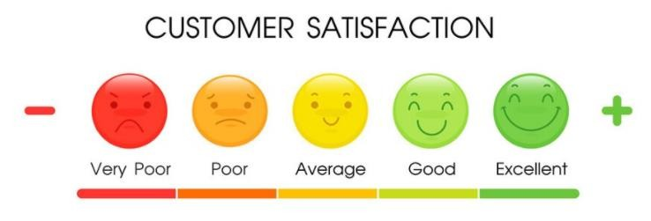
What is software quality?
Software quality – IEEE definition:
The degree to which a system, component, or process meets specified requirements.

Slide 4
Error - Fault - Failure
Error
Also known as mistake.
An error can be a Syntax (grammatical) error or Logic
A software error made by human action which produces an incorrect
result.
Fault
Also known as a defect or bug.
A fault is a manifestation of an error in software
All software errors may not cause software faults
Failure
A fault becomes a failure if it is activated/executed.
deviation of the software from its expected delivery or service
Not all faults result in failures; some stay dormant in the code and we may never
notice them.
Failure is an event;
Fault is a state of the software, caused by an error

Slide 5

Error - Fault - Failure
A person makes an error
...
… that creates a fault in the software ...
… that can cause a failure in operation

Slide 6



















Error - Fault - Failure
Software development process
software error
software fault software failure

Slide 7
Causes of software errors
Errors may occur for many reasons, such as:
Time pressure
Human is error prone
Inexperienced or insufficiently skilled project participants
Miscommunication between project participants, including miscommunication about requirements and design
Complexity of the code, design, architecture, the underlying problem to be solved, and the technologies used
New, unfamiliar technologies

Slide 8

Definitions of Software Testing?
Software Testing the process consisting of all lifecycle activities, both static and dynamic, concerned with planning, preparation and evaluation of software products and related work products to determine that they satisfy specified requirements, to demonstrate that they are fit for purpose and to detect defects.

Slide 9
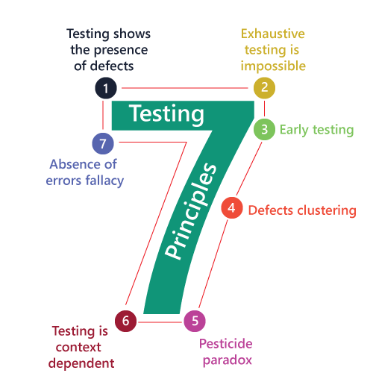
Principles of Testing

Slide 10
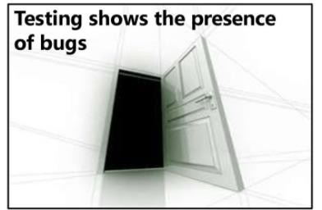
Principles of Testing
Principle 1:
Testing can show that defects are present , but cannot prove that there are no defects.

Slide 11
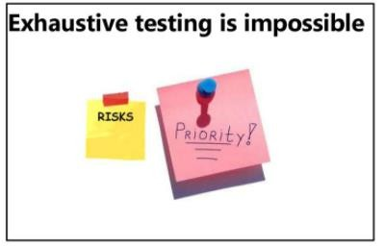
Principles of Testing
Principle 2:
Exhaustive testing means to test everything, all preconditions and combinations of inputs.
Testers should apply risk analysis and set priorities to focus testing efforts.

Slide 12
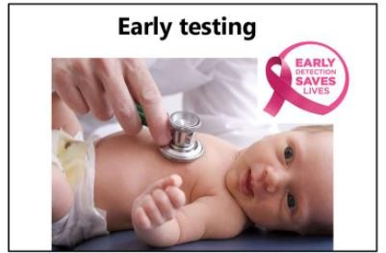
Principles of Testing
Principle 3:
Testing activities should start as early as possible in the software or system development life cycle and should be focused on defined objectives.

Slide 13
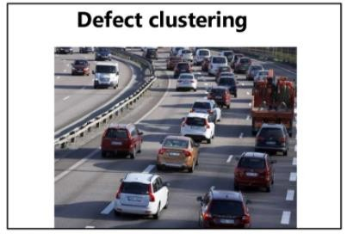
Principles of Testing
Principle 4:
A small number of modules contain most of the defects discovered during pre-release testing or show the most operational failures.

Slide 14
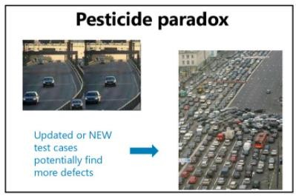
Principles of Testing
Principle 5:
If the same tests are repeated over and over again, eventually the same set of test cases will no longer find any new bugs.
To overcome this 'pesticide paradox', the test cases need to be regularly reviewed and revised, and new and different tests need to be written to exercise different parts of the software or system to potentially find more defects.

Slide 15

Principles of Testing
Principle 6:
Testing is done differently in different dependent contexts.
For example, safety-critical software is tested differently from an e-commerce site.

Slide 16
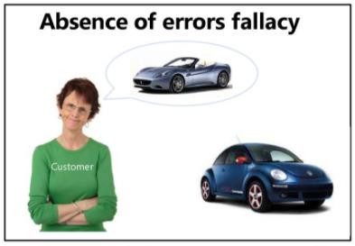
Principles of Testing
Principle 7:
Finding and fixing defects does not help if the system built is unusable and does not fulfill the users' needs and expectations.

Slide 17
Why Testing is necessary?
All Software has defects (bugs)
Software products are getting larger and more complicated
Software is written by people – people make mistakes

Slide 18
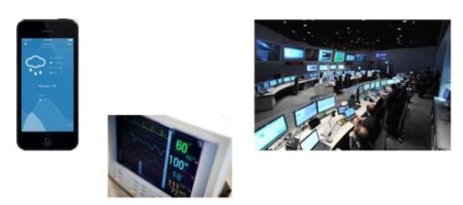
Why Testing is necessary?
Some of the problems might be trivial, but others can be costly and damaging- with loss of money, time, or business reputation – and even may result in injury or death
Not all software systems carry the same level of risk and not all problems have the same impact when they occur

Slide 19
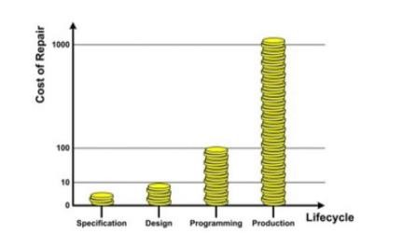
Why Testing is necessary?
Cost of defects: the cost to finding and fixing defects rises considerably across the life cycle

Slide 20
Why Testing is necessary?
Software testing looks to find the most important defects as early as possible – increasing confidence that the software meets specification
Help to measure the quality of software

Slide 21
Software Testing Objectives
To identify and reveal as many errors as possible
To gain confidence about the level of quality
To prevent defects
To provide information for decision-making (stakeholders)
To reduce the level of risk of inadequate of software quality
To make sure that the system works as expected, meets the user requirements
To comply with the contractual, legal or regulatory requirements or standards

Slide 22
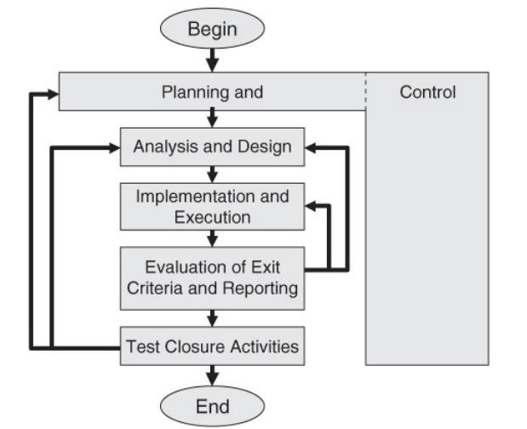
Fundamental Test Process
The five stages of the fundamental test process:

Slide 23
Test Planning
Major tasks are:
“A goal without a plan is just a wish”
Identify the objectives of testing
Determine scope
Determine the Test Approach
Determine the required test resources
Implement the test policy and/or the test strategy
Schedule test analysis and design tasks
Schedule test implementation, execution and evaluation
Determine the Exit Criteria

Slide 24
Test Planning
Test Control:
The ongoing activity of comparing actual progress against the plan
Reporting status, including deviations from the plan
Taking actions necessary to meet the mission and objectives of the project
Test Planning takes into account the feedback from monitoring and control activities
Major tasks are:
Measure and analyze results
Monitor and document progress, test coverage and exit criteria
Initiate corrective actions
Make decisions

Slide 25
Analysis and design
“Analysis gain better understanding”
Review the Test Basis: - in doing so evaluate testability of Test Basis and Test Objects(s).
Identify and prioritize Test Conditions and associated Test Data.
Test Conditions and associated Test Data are documented in a Test Design Specification.
Design and prioritize the Test Cases
Identify Test Data required to support Test Cases
Design the test environment set-up
Identify any required infrastructure and tools

Slide 26
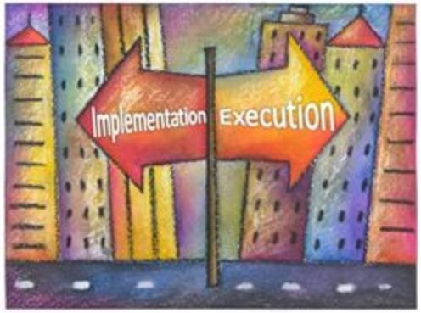
Implementation and Execution
Develop, implement and
priorities Test case
“Ideas are Easy. Implementation is hard”
Create the Test Scripts
Create test data
Write automated test scripts
Check the environment – Verify that the test environment has been set up correctly

Slide 27
Evaluating exit criteria and reporting
“Evaluation- Learning tool to Improve”
Evaluating exit criteria is the activity where test execution is assessed against the defined objectives.
Exit criteria should be set and evaluated for each test level
Check test logs against the exit criteria specified in the test planning
Assess if more tests are needed or if the exit criteria specified should be changed.
Write a test summary report to stakeholders

Slide 28
Evaluating exit criteria and reporting
How to measure exit criteria?
All the planned requirements must be met
All the high Priority bugs should be closed
All the test cases should be executed
If the scheduled time out is arrived
Test manager must sign off the release
Note: All these parameters can be met by percentages (not 100%)

Slide 29
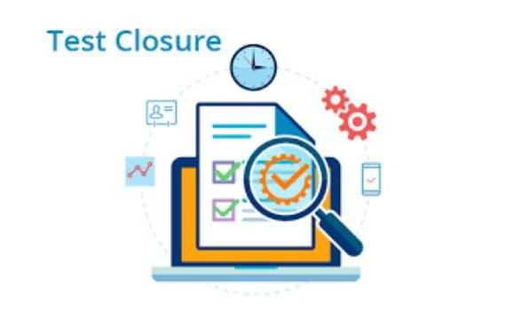
Test closure activities
“Closure – Way to start new beginning”
Collect data from complete test activity
Finalize and archive the test ware
Test wares such as scripts, test environment etc.
Evaluate how testing went and analyze lessons learned for future releases and projects

Slide 30
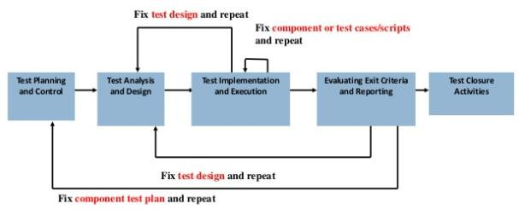
Fundamental Test Process

Slide 31




